Slide 1
SU1 - Introduction to computing; history; program-design methods; ethics
CMPG111 – Introduction to Computing & Programming

Slide 2
OUTCOMES SU1 Introduction to computing; history; program-design methods; ethics
On completion of this study unit, you should be able to:
Define the Turing and Von Neumann models of a computer;
Describe and list topics related to the three components of a computer; hardware, data and software;
Describe, list and distinguish between the three subsystems of a computer; CPU, memory, and input/output;
History of computing systems;
Describe the basic phases of software development: analysis, design, coding, and testing;
Define three ethical principles related to the use of computers;
Define intellectual property and list its types, define privacy in relation to the use of computers, define computer crimes, and discuss types of attacks, its motivation, and how to protect oneself, and define hackers and the damage they do.
Foundations of Computer Science CHAPTER 1, pp 1 - 11
Foundations of Computer Science CHAPTER 5.1 – 5.4: pp 91 – 104
Fundamentals of Python – CHAPTER 1: pp 9 – 22
CHAPTER 2: pp 34 – 41
Foundations of Computer Science CHAPTER 1, pp 1 - 11
Foundations of Computer Science – (CHAPTER 20: pp 525 – 532)

Slide 3
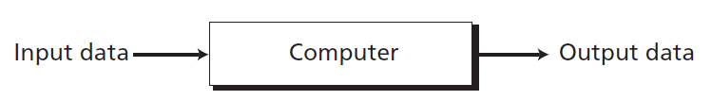
Define the Turing and Von Neumann models of a computer
A single-purpose computing machine
The idea of a universal computational device was first described by Alan Turing in 1937. He proposed that all computation could be performed by a special kind of a machine, now called a Turing machine.
Although Turing presented a mathematical description of such a machine, he was more interested in the philosophical definition of computation than in building the actual machine.
Foundations of Computer Science CHAPTER 1, pp 1 - 11

Slide 4
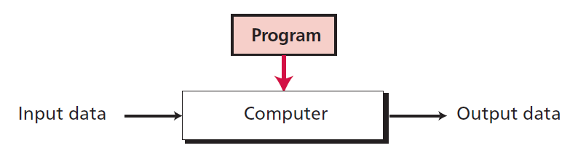
Define the Turing and Von Neumann models of a computer
A computer based on the Turing model (programmable data processor)
Foundations of Computer Science CHAPTER 1, pp 1 - 11

Slide 5
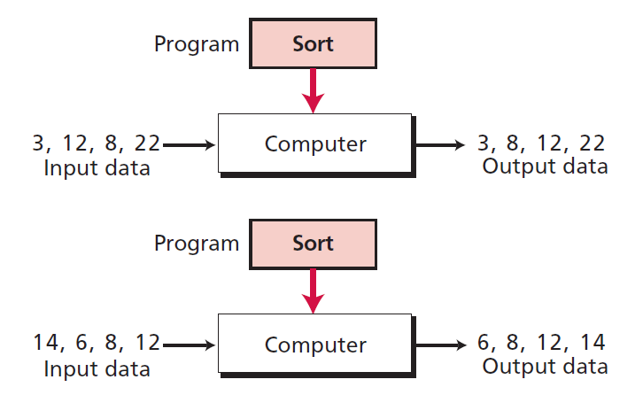
Define the Turing and Von Neumann models of a computer
Same program, different data
Foundations of Computer Science CHAPTER 1, pp 1 - 11

Slide 6
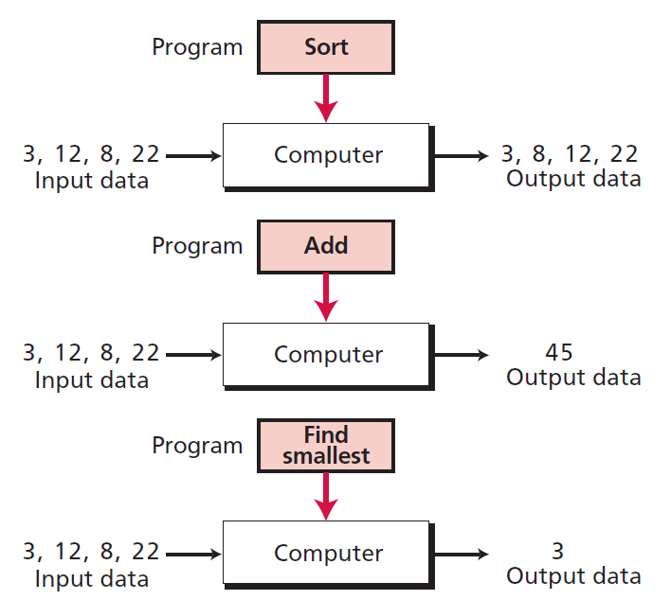
Define the Turing and Von Neumann models of a computer
Same data, different programs
Foundations of Computer Science CHAPTER 1, pp 1 - 11

Slide 7
Define the Turing and Von Neumann models of a computer
Computers built on the Turing universal machine store data in their memory. Around 1944–1945, John von Neumann proposed that, since a program and data are logically the same, programs should also be stored in the memory of a computer.
Foundations of Computer Science CHAPTER 1, pp 1 - 11

Slide 8
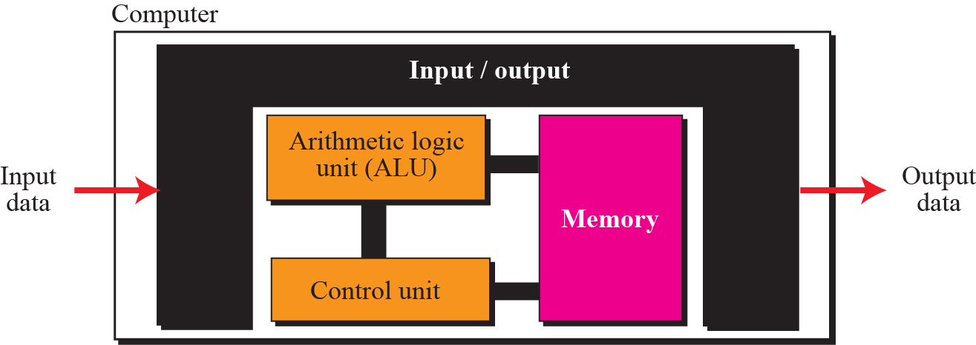
Define the Turing and Von Neumann models of a computer
The Von Neumann model
Foundations of Computer Science CHAPTER 1, pp 1 - 11

Slide 9
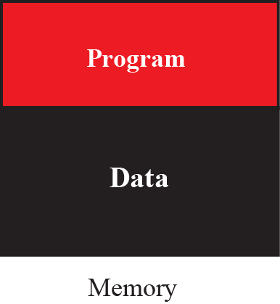
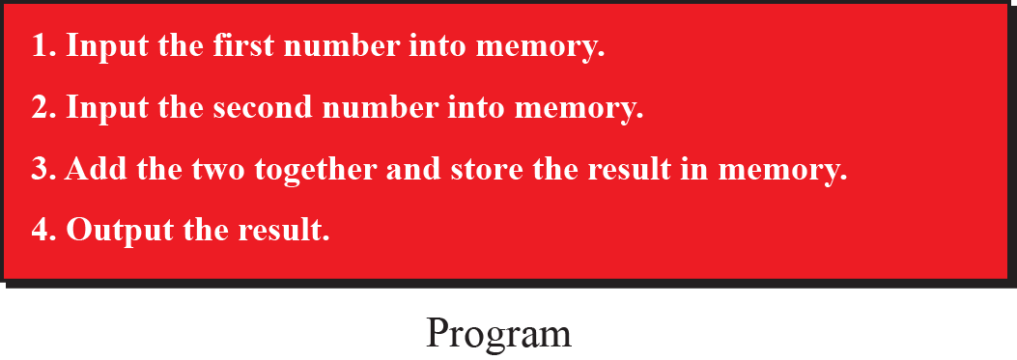
Describe and list topics related to the three components of a computer; hardware, data and software
We can think of a computer as being made up of three components:
computer hardware,
data, and
computer software.
Foundations of Computer Science CHAPTER 1, pp 1 - 11

Slide 10
List the three subsystems of a computer
Describe the role of the CPU;
Describe the main memory;
Describe the input/output subsystem.
We can divide the parts that make up a computer into three broad categories or subsystems:
the central processing unit (CPU),
the main memory, and
the input/output subsystem.
Foundations of Computer Science CHAPTER 5.1 – 5.4: pp 91 – 104

Slide 11
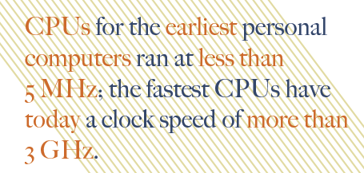
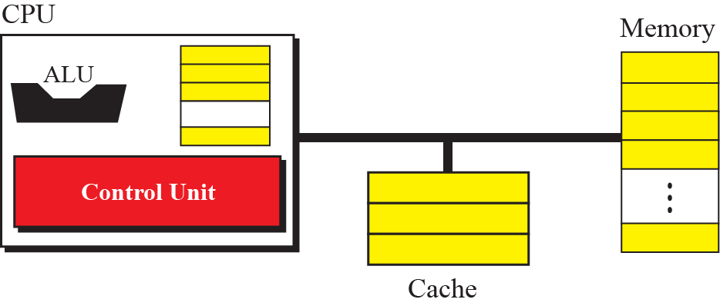
List the three subsystems of a computer
Describe the role of the CPU;
Describe the main memory;
Describe the input/output subsystem.
It is a computer chip that performs the calculations and comparisons needed for processing; it also controls the computer’s operations.
The CPU clock speed measures of the number of instructions that can be processed per second.
Cache memory is a special group of very fast memory circuitry located on or close to the CPU that is used to speed up processing by storing the data and instructions that may be needed next by the CPU in handy locations.
The central processing unit (CPU) performs operations on data. In most architectures it has three parts:
an arithmetic logic unit (ALU),
a control unit, and
a set of registers, fast storage locations.
Foundations of Computer Science CHAPTER 5.1 – 5.4: pp 91 – 104

Slide 12
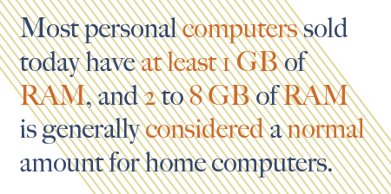
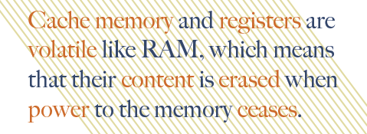
List the three subsystems of a computer
Describe the role of the CPU;
Describe the main memory;
Describe the input/output subsystem.
Memory is chips located inside the system unit that the computer uses to store data and instructions while it is working with them.
RAM (random access memory) is used to store the essential parts of the operating system while the computer is running, as well as the programs and data that the computer is currently using.
A register is high-speed memory built into the CPU that temporarily stores data during processing.
ROM (read-only memory) consists of nonvolatile chips that permanently store data or programs.
Flash memory consists of nonvolatile memory chips that can be used for storage by the computer or the user.
Flash memory chips have begun to replace ROM for storing system information.
Main memory consists of a collection of storage locations, each with a unique identifier, called an address.
Data is transferred to and from memory in groups of bits called words. If the word is 8 bits, it is referred to as a byte.
Foundations of Computer Science CHAPTER 5.1 – 5.4: pp 91 – 104

Slide 13
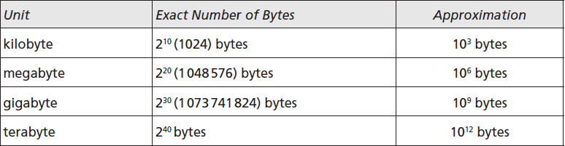
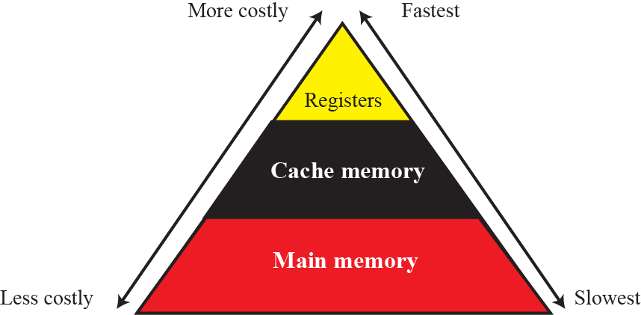
List the three subsystems of a computer
Describe the role of the CPU;
Describe the main memory;
Describe the input/output subsystem.
How do measure data?
Cost vs speed
Foundations of Computer Science CHAPTER 5.1 – 5.4: pp 91 – 104

Slide 14
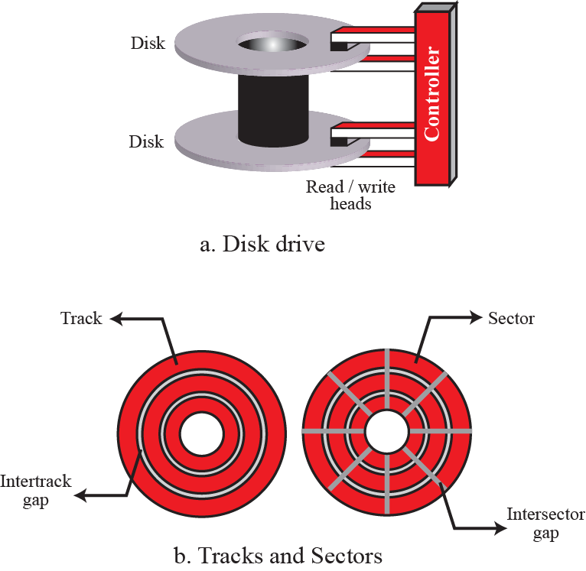
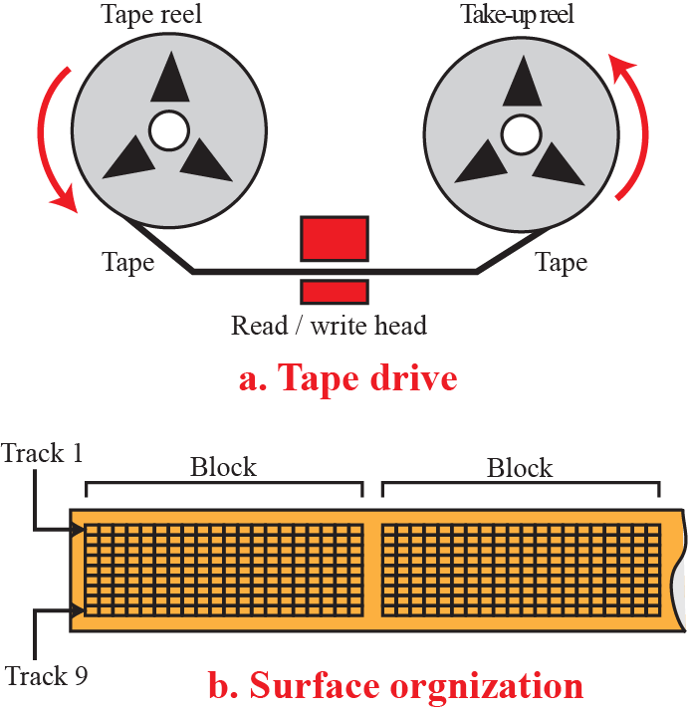
List the three subsystems of a computer
Describe the role of the CPU;
Describe the main memory;
Describe the input/output subsystem.
Can you think of I/O devices?
The input/output (I/O) subsystem allows a computer to communicate with the outside world, and to store programs and data even when the power is off.
Input/output devices can be divided into two broad categories:
non-storage, and
storage devices.
Magnetic disc
Magnetic tape
Foundations of Computer Science CHAPTER 5.1 – 5.4: pp 91 – 104

Slide 15
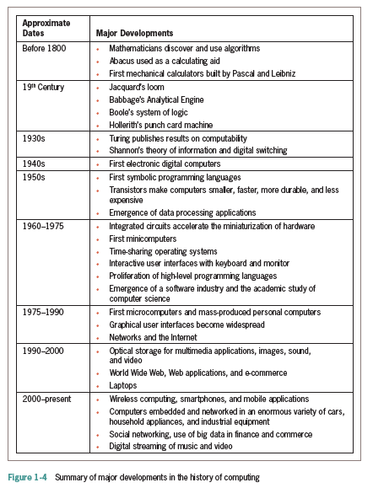
History of computing systems
The history of computing and computers. We divide this history into three periods
Mechanical machines (before 1930)
The birth of electronic computers (1930–1950)
Computer generations (1950–present)
You will find a lot of information in our textbook!
Foundations of Computer Science CHAPTER 1, pp 1 - 11
Fundamentals of Python – CHAPTER 1: pp 9 – 22

Slide 16

The Software Development Process
Describe the basic phases of software development: analysis, design, coding, and testing
Software development: process of planning and organising a program
Several approaches; one is the waterfall model
Modern software development is usually incremental and iterative
Analysis and design may produce a prototype of a system for coding, and then back up to earlier phases to fill in more details after some testing
Fundamentals of Python –CHAPTER 2: pp 34 – 41

Slide 17
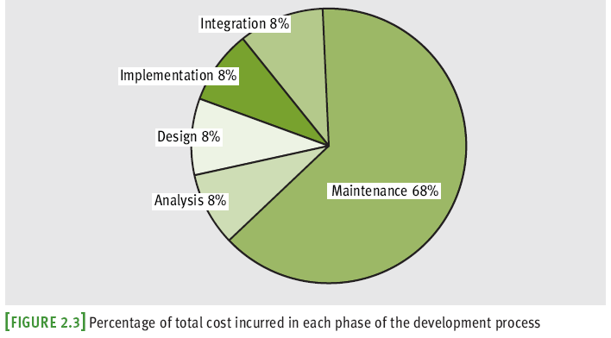
The Software Development Process
Programs rarely work as hoped the first time they are run
Must perform extensive and careful testing
The cost of developing software is not spread equally over the phases
Fundamentals of Python - CHAPTER 2.1 - 2.2: pp 39 - 47

Slide 18
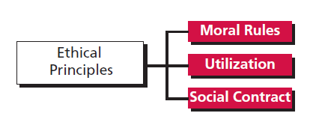
Define three ethical principles related to the use of computers
Computer science has created some peripheral issues, the most prevalent of which can be categorized as social and ethical issues.
PRINCIPLE 1: When we make an ethical decision, we need to consider if the decision is made in accordance with a universally accepted principle of morality.
For example, if we want to illegally access a computer to get some information, we need to ask ourselves if this act is moral. We know that most people in the world do not consider such actions to be moral, which means that we would be ignoring the first principle of ethics if we acted in this way.
PRINCIPLE 2: The consequences of the act. An act is ethical if it results in consequences which are useful for society.
For example, if a person accesses a bank’s computer and erases customer records, is this act useful for society? Since this action may damage the financial status of the bank’s customer, it is detrimental to society. It does not bring about a good result. It is not ethical.
Principle 3: An act is ethical when a majority of people in society agrees with it.
For example: if someone breaks into somebody else’s house and commits a robbery, does this act receive the approval of a majority of society? Since the answer is negative, this act is not ethical.
Foundations of Computer Science – (CHAPTER 20: pp 525 – 532)

Slide 19
Define intellectual property and list its types, define privacy in relation to the use of computers, define computer crimes, and discuss types of attacks, its motivation, and how to protect oneself, and define hackers and the damage they do
Intellectual vs physical property:
1. A physical property cannot be copied; it needs to be manufactured or built. If we need another computer, we need to physically build it. On the other hand, intellectual property can be copied. We can make a copy of a book without rewriting it.
2. Copying intellectual property still leaves the owner with the original. Stealing a computer deprives the owner of its use.
3. The owner of intellectual property is only one person (or a group); many people can have the same physical property.
Foundations of Computer Science – (CHAPTER 20: pp 525 – 532)

Slide 20

Define intellectual property and list its types, define privacy in relation to the use of computers, define computer crimes, and discuss types of attacks, its motivation, and how to protect oneself, and define hackers and the damage they do
Types of intellectual property:
Trademarks – identifies a company’s product or service. A trademark is an intellectual property right granted by the government for a limited term, but which can be renewed. A trademark is considered intellectual property in that the corresponding product cannot legally be copied by other companies or individuals,
Trade secrets – is the information about a product that is kept secret by the owner. For example, a company can create a product but keep the formula secret. A programmer can create a piece of software, but keep the program code secret. People can use the product or the software, but they do not own the formula or the code. Unlike trademarks, a trade secret does not have to be registered; the owner just has to keep it secret,
Patents – a right to a monopoly to use and commercially exploit a piece of intellectual property for a limited period of time. The owner has the right to give or not to give permission to anyone who wishes to use the invention. However, the individual property needs to have certain characteristics such as novelty, usefulness, and the capability of being built, and
Copyright – a right to a written or created work. It gives the author the exclusive rights to copy, distribute, and display the work. Copyright arises automatically, and does not need to be applied for or formally registered, but a statement of the creator’s copyright should be mentioned somewhere on the work.
How to make coke?
Voltaren vs Panamor
Books, music, art, software
Foundations of Computer Science – (CHAPTER 20: pp 525 – 532)

Slide 21

Define intellectual property and list its types, define privacy in relation to the use of computers, define computer crimes, and discuss types of attacks, its motivation, and how to protect oneself, and define hackers and the damage they do
Codes of ethics related to the use of computers to collect data:
Collect only data that are needed.
Be sure that the collected data are accurate.
Allow individuals to know what data have been collected.
Allow individuals to correct the collected data if necessary.
Be sure that collected data are used only for the original purpose.
Use encryption techniques to accomplish private communication.
The POPI Act (13 November 2013) sets out the minimum standards regarding accessing and 'processing' of any personal information belonging to another. The Act defines 'processing' as collecting, receiving, recording, organizing, retrieving, or the use, distribution or sharing of any such information.
Foundations of Computer Science – (CHAPTER 20: pp 525 – 532)

Slide 22
Define intellectual property and list its types, define privacy in relation to the use of computers, define computer crimes, and discuss types of attacks, its motivation, and how to protect oneself, and define hackers and the damage they do
A computer crime is an illegal act, called an attack, involving any of the following:
1. A computer
2. A computer network
3. A computer-related device
4. Software
5. Data stored in a computer
6. Documentation related to the use of computers
Foundations of Computer Science – (CHAPTER 20: pp 525 – 532)

Slide 23
Define intellectual property and list its types, define privacy in relation to the use of computers, define computer crimes, and discuss types of attacks, its motivation, and how to protect oneself, and define hackers and the damage they do
Types of attacks
Attacks can be divided into two categories:
1. Penetration
Viruses are unwanted programs that are hidden within other programs (host). When the user executes the host program, the virus takes control and replicates itself by attaching itself to other programs. Eventually, the multitude of viruses may stop normal computer operations. Viruses can also be transferred to other machines through the network.
Worms is an independent program which can copy itself and which travels through the network. It is a self-replicating piece of software that can travel from one node to another. It tries to find weaknesses in the system to inflict harm. It can reproduce many copies of itself, thus slowing down access to the Internet or stopping communication altogether.
Trojan horse is a computer program that does perform a legitimate task, but which also contains code to carry out malicious attacks such as deleting or corrupting files. It can also be used to access user passwords or other secret information, and
2. Denial of service
The denial of service is an attack on a computer connected to the Internet. These attacks
reduce the capability of a computer system to function correctly or bring the system
down altogether by exhausting its resources.
PROTECTION
Use physical protection: allow physical access only to trusted individuals.
Use protective software: data encryption or the use of strong passwords to access software.
Install strong anti-virus software: control access to the computer when installing new software or accessing Internet sites.
Motives
Attacks are made with many different motivations such as political reasons, a hacker’s personal interpretation of computer ethics, terrorism, espionage, financial gain, or hate.
Foundations of Computer Science – (CHAPTER 20: pp 525 – 532)

Slide 24
Define intellectual property and list its types, define privacy in relation to the use of computers, define computer crimes, and discuss types of attacks, its motivation, and how to protect oneself, and define hackers and the damage they do
The word hacker today has a different meaning than when it was used in the past. Previously, a hacker was a person with a lot of knowledge who could improve a system and increase its capability. Today, a hacker is someone who gains unauthorized access to a computer belonging to someone else in order to copy secret information.
Foundations of Computer Science – (CHAPTER 20: pp 525 – 532)

Slide 25
Thank you for listening!
Any questions?

